Slide 1
Programming Language Concepts
Introduction
Spring 2021

Slide 2
Important Information About Me
James Heliotis
jehics@rit.edu
My schedule
Office Hours https://rit.zoom.us/j/400017098 (ID 400 017 098)
Mondays 2:15-3:15 PM
Tuesdays 3:15-4:15 PM
Thursdays 11:00 AM – 12:00 PM
Course
Zoom Meeting id = 967 3563 6322
https://rit.zoom.us/j/96735636322

Slide 3
Resources
Instructor Information
www.cs.rit.edu/~jeh
Main Course Web Page
www.cs.rit.edu/usr/local/pub/jeh/courses/344
mycourses
Grades
Discussion Forums
PLCC: The course Software
Principal author Prof. Timothy Fossum
http://www.cs.rit.edu/usr/local/pub/jeh/PLCC

Slide 4
Let's Review…
The syllabus
The schedule

Slide 5
Let's Begin…

Slide 6
Syntax versus Semantics
Can anyone suggest an English sentence that is grammatically well-structured but would be semantically nonsensical?
Do all natural languages have similar grammars?
Are all natural languages capable of conveying the same ideas?
What kind of elements would you talk about if writing a grammar for a natural language like English?
Notes:
The cow jumped over the moon.
I have to sleep her formula.
My master plan told me to say.
My father / mi padre
O meu pai
Ο πατέρας μου

Slide 7
Programming Languages are Simpler!
Far fewer concepts to explain
No ambiguity
No dependence on “reader’s” experience
Changes decided officially by a few, instead of through evolution.

Slide 8
Tokenizing
In natural languages, units of meaning are called morphemes.
In programming languages we speak of source text as being composed of tokens.
structure Token { token type; lexeme string }
State some token types of your favorite programming languages.
Give sample lexemes.

Slide 9
The Essence of Language Processing

Slide 10
a tangent:

Slide 11
Breaking Down a Sentence: I was looking for some games.

Slide 12
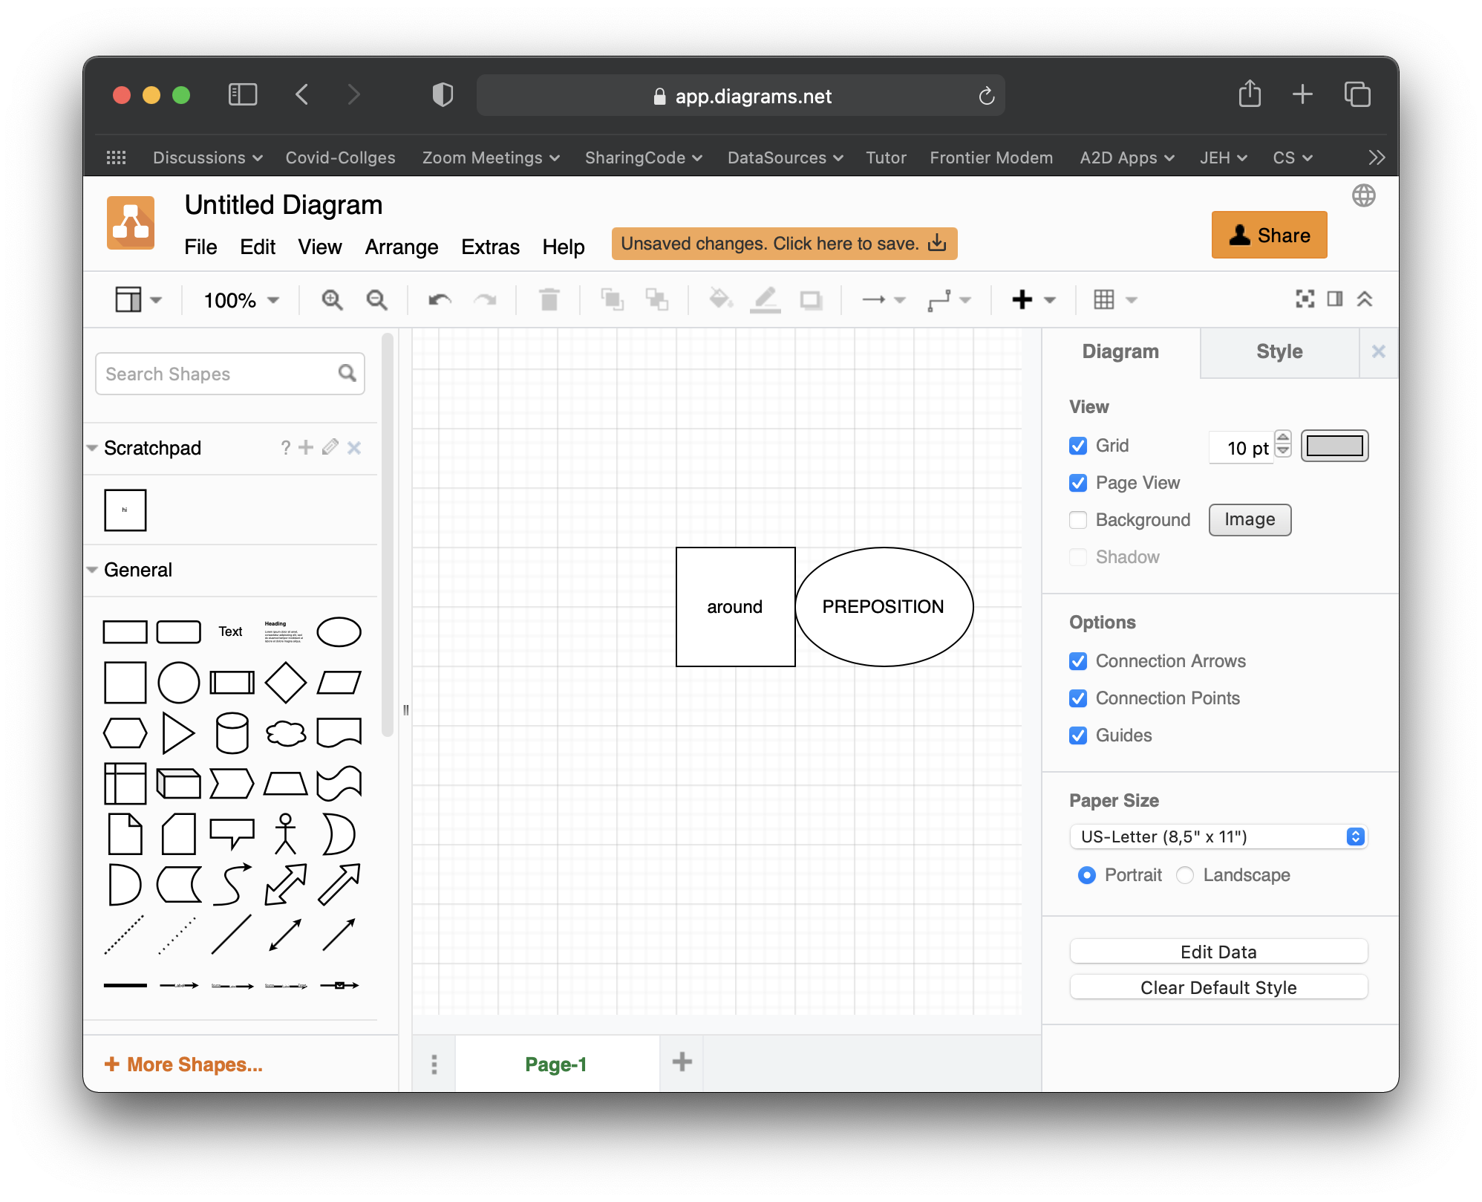
Group Exercise
You will be drawing a parse tree.
You will be broken into groups of three.
You will use draw.io
Each participant’s name must be on the diagram for credit.
Share diagram on Google Docs (RIT).
Afterwards, upload to Assignment in mycourses.

Slide 13
Break down this program code into its elements.
Consider both tokens and syntactic structure.
public class Div {
public static void main(String [] args) {
System.out.println(18/5);
}
}

Slide 14
Comments on Students' Submissions
The tree represents a breaking down of the structure into smaller and smaller elements.
Arrows should all point downward away from the root of the tree.
Although punctuation is necessary in the source, it is often not needed in the tree.
Keywords like "class" will usually disappear, too.
Something like "static" may end up being a boolean flag in the node above.
Interesting case: System.out.println(...);
The main method subtree should probably have two children: one for return type and one for list-of-arguments.
Internal nodes don't have lexemes attached to them.
"String[]" would likely be split into 3 tokens.

Slide 15
For those who could not attend…
Complete the "whiteboard drawing" solution for the exercise.
Working with others is OK.

Slide 16
A Programming Language's Specification
A programming language spec should include two things:
syntax rules (tokens, grammar)
semantics

Slide 17
Is Syntax Enough?
Sometimes you can figure out the semantics from syntax
if statement
operator + (maybe)
But what about...
Operator precedence?
The semantics of generics in Java, or templates in C++?
Primitive data types?
Behavior of a procedure call?
The meaning of keywords like None, null, nil, or Void?

Slide 18
Example: Tokens Without Grammatical Context
Python: the int class has a method __add__.
When you write a + b it is automatically converted to a.__add__( b ) # (which is also legal)
Then why does this not work?
5.__add__( 8 )
Notes:
5.__add__( 8 ) does not work.
These do work:
a = 5
a.__add__( 8 )
5 .__add__( 8 )
(5).__add__( 8 )
[and with float results...]
5..__add__( 8 )

Slide 19
Ensuring Correct Programs
What can you do to specify what your code is supposed to do, and have it checked automatically?
In the end, any formal notation is subject to errors and misunderstandings by humans.
Notes:
Assertions, Pre/Post Conditions, Loop Variants, Class Invariants, Z/Alloy/OCL

Slide 20
How to Describe a Set of Strings for a Token
Regular Expressions (regexes)
Strings that represent sets of strings
⇒ Some characters are special: . * [ ] etc.
For example, Python:
https://docs.python.org/3/library/re.html
Java:
https://www.cs.rit.edu/usr/local/jdk/docs/api/java.base/java/util/regex/Pattern.html
Examples follow.

Slide 21
A Few Examples
Regular | String | Matches?
Expression
'hell' | 'Well hello world!' | YES
'hello|goodbye' | 'Well hello world!' | YES
'[0-9]' | 'When I'm 64 ...' | YES
'^[0-9]$' | 'When I'm 64 ...' | NO
'^\d*$' | '2525' | YES
'^\d*$' | '2525a' | NO
More examples can be found in the file regexes.txt.

Slide 22
Regexes are Incredibly Useful
Example: text editors
Vim
Jetbrains source editor
… many more
Search for calls to method foo:
\.foo(.*)
Change brackets to braces in LaTeX hyperref invocations:
s/href\[\(.*\)\]/href{\1}/

Slide 23
Exercise
Propose a regular expression that matches floating point constants
5.86
.83
19e5
2.62E+23
1e-9
-83.
You should not match integers.
Exponents are at most two (decimal) digits.
Notes:
[-+]?(((\d*\.\d+)|(\d+\.\d*))|(((\d*\.\d+)|(\d+\.\d*)|\d+)[eE][+-]?\d{1,2}))
(This version works in JetBrains editor.)

Slide 24
How to Match Regular Expressions
a
b,c
b,c
a
A state machine!
a
a[bc]+
a,b,c

Slide 25
Regex text can be automatically converted to a finite state machine.
a[bc]+

Slide 26
... and a finite state machine can be simulated in conventional software.
current state → ↓ input | S1 | S2 | S3 | S4
a | S2 | S4 | S4 | S4
b | S4 | S3 | S3 | S4
c | S4 | S3 | S3 | S4
S1
S2
S3
next state
S4
Algorithm maintains current state and
reads one character at a time to choose next state.

Slide 27
Scanners / Lexical Analyzers

Slide 28
How to Make Tokens
Open an input stream on the source text.
Scan for non-white-space.
Capture and remove non-white-space characters from the start of the stream. Put them in a string lex.
While the scan succeeded
Find a token regex that matches lex in its entirety.
Pass the token type and lex string to the parser.
Skip white space in input stream.
Capture next non-white-space sequence from stream in lex.
Match each separately.

Slide 29
Whitespace a Necessity?
Most languages need whitespace, but punctuation can often help.
How can you tokenize this?
ifx>0x=x-1elsey=2

Slide 30
Next...
Learn how to specify a lexical scanner with PLCC.

